Slide 1
Lecture 6: Evaluation of Machine Learning Models
Instructor: Yang Xu

Slide 2
Outline of today
Dataset: Training, testing, validation
Performance metrics for regression model
Performance metrics for classification model
Overfitting & regularization

Slide 3
Train/dev/test sets
Making good choices makes a huge difference
Data
Workflow:
- Keep on training models on training set
- Use dev set to see which model performs best
- Evaluate the final model on test set to get a an unbiased estimate
Training set
Proportions for small data (100, 1k, 10k examples):
70/./30 % split, or 60/20/20 % split
Development set (“dev”)
a.k.a hold-out cross validatioan
Modern “Big data” era:
E.g. 1,000,000 data points.
1,000,000 / 10,000 / 10,000 → 98/1/1 % split
Test set
Or 99.5/.25/.25 %, 99.5/.4/.1 % split

Slide 4
Mismatched train/test distribution
Modern deep learning (deep neural networks) models trained on different train and test distributions.
Task: predict fish species from fish image
Training set: millions of images of fish crawled from web
Dev/test sets: images uploaded by users
High quality images
Blur, low quality
Rule-of-thumb: make sure that the dev and test sets are from the same distribution.
It might be okay to not have a test set, but may cause overfitting to dev set

Slide 5
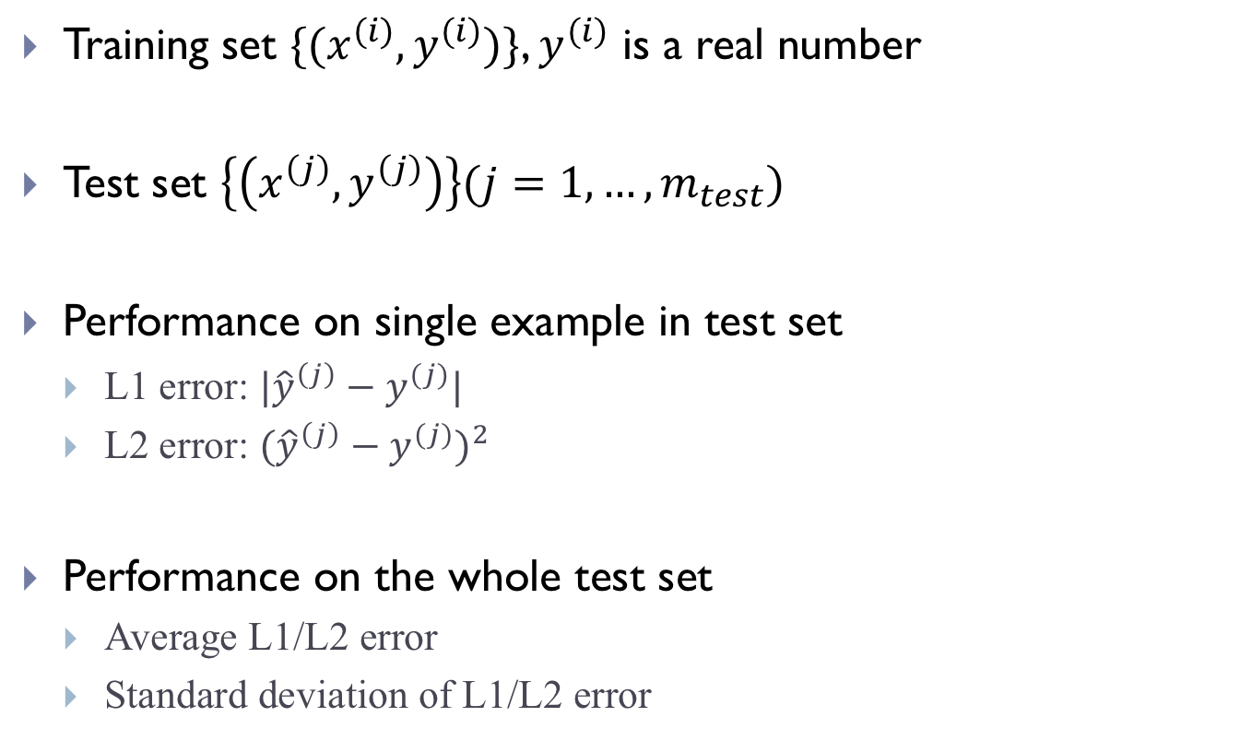
Performance metrics for regression model
Training set $\{(x^{(i)},y^{(i)})\}$, $y^{(i)}$ is a real number
Test set $\left\{\left(x^{\left(j\right)},y^{\left(j\right)}\right)\right\}(j=1,…,m_{test})$
Performance on single example in test set
L1 error: $|{\hat{y}}^{\left(j\right)}−y^{(j)}|$
L2 error: ${({\hat{y}}^{\left(j\right)}−y^{(j)})}^{2}$
Performance on the whole test set
Average L1/L2 error
Standard deviation of L1/L2 error

Slide 6
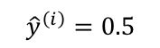
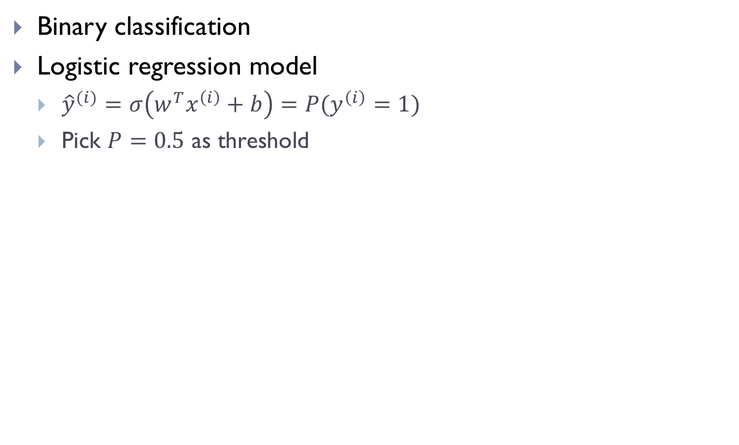
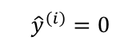
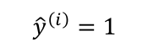
Performance metrics for classification model
Binary classification
Logistic regression model
${\hat{y}}^{(i)}=σ\left(w^{T}x^{\left(i\right)}+b\right)=P(y^{\left(i\right)}=1)$
Pick $P=0.5$ as threshold
$${\hat{y}}^{\left(i\right)}=0.5$$
$${\hat{y}}^{\left(i\right)}=0$$
$${\hat{y}}^{\left(i\right)}=1$$

Slide 7
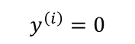
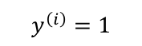
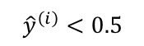
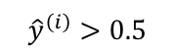
Confusion matrix
Negative prediction
Positive prediction
$${\hat{y}}^{\left(i\right)}<0.5$$
$${\hat{y}}^{\left(i\right)}>0.5$$
1
12
Positive label
$$y^{\left(i\right)}=1$$
Negative label
11
2
$$y^{\left(i\right)}=0$$

Slide 8
Point matric: True Positives (TP)
Negative prediction
Positive prediction
1
12
Positive label
2
Negative label
11
TP
12
True Positive: “yes” examples correctly identified as “yes”

Slide 9
Point matric: True Negatives (TN)
Negative prediction
Positive prediction
1
12
Positive label
2
Negative label
11
TP | TN
12 | 11
True Negative: “no” examples correctly identified as “no”

Slide 10
Point matric: False Positive (FP)
Negative prediction
Positive prediction
1
12
Positive label
2
Negative label
11
TP | TN | FP
12 | 11 | 2
False Positive: “no” examples incorrectly identified as “yes”

Slide 11
Point matric: False Negative (FN)
Negative prediction
Positive prediction
1
12
Positive label
2
Negative label
11
TP | TN | FP | FN
12 | 11 | 2 | 1
False Negative: “yes” examples incorrectly identified as “no”

Slide 12
Understand FP and FN with one picture
Source: https://marginalrevolution.com/marginalrevolution/2014/05/type-i-and-type-ii-errors-simplified.html

Slide 13
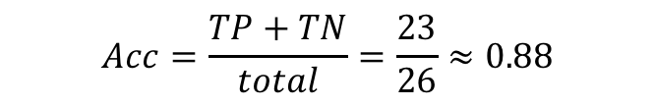
Point matric: Accuracy
Negative prediction
Positive prediction
1
12
Positive label
2
Negative label
11
TP | TN | FP | FN | Acc
12 | 11 | 2 | 1 | .88
$$Acc=\frac{TP+TN}{total}=\frac{23}{26}≈0.88$$
Accuracy: the fraction of correct predictions among all

Slide 14

Point matric: Precision
Negative prediction
Positive prediction
1
12
Positive label
2
Negative label
11
TP | TN | FP | FN | Acc | Pr
12 | 11 | 2 | 1 | .88 | .86
$$Pr=\frac{TP}{TP+FP}=\frac{12}{14}≈0.86$$
Precision: the quality of positive predictions

Slide 15

Point matric: Recall
Negative prediction
Positive prediction
1
12
Positive label
2
Negative label
11
$$Re=\frac{TP}{TP+FN}=\frac{12}{13}≈0.92$$
TP | TN | FP | FN | Acc | Pr | Re
12 | 11 | 2 | 1 | .88 | .86 | .92
Recall: the fraction of correctly predicted examples among all positive ones. A.k.a., sensitivity.

Slide 16

Point matric: F1 score (a.k.a., F score, F measure)
Negative prediction
Positive prediction
1
12
Positive label
2
Negative label
11
$$Re=\frac{2∗(Pr∗Re)}{Pr+Re}≈0.92$$
TP | TN | FP | FN | Acc | Pr | Re | F1
12 | 11 | 2 | 1 | .88 | .86 | .92 | .89
F1 score combines Precision and Recall

Slide 17
ROC curve (receiver operating characteristic)
Plot True Positive Rate vs. False Positive Rate
Larger area under curve (AUC) on ROC curve means better performance

Slide 18
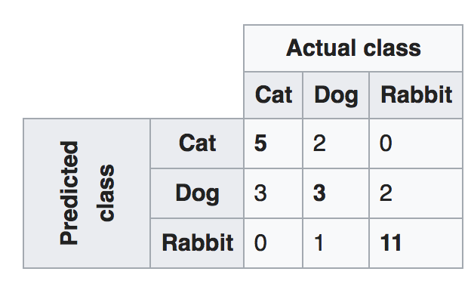
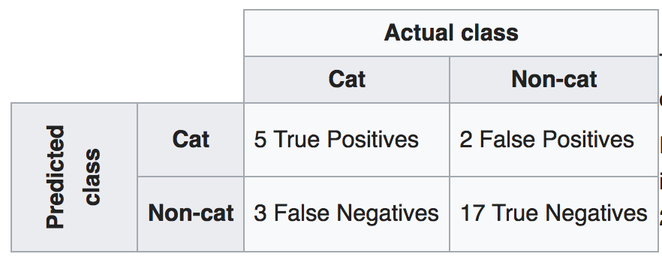
Confusion matrix for multiclass classifier

Slide 19
Precision Recall tradeoff
Negative prediction
Positive prediction
FN
TP
Positive label
FP
Negative label
TN
Preference depends on task:
- Terrorist face detection at border
- Culprit or innocent to punish
- Brain surgery to remove tumor cells (being conservative vs. bold)

Slide 20
Overfitting
Overfitting: the model parameters fit the data too well, and therefore fail to fit new data, or to predict reliably.
An overfitted model essentially explains the idiosyncrasies in data, rather than some general and stable patterns.
Cause: too many parameters trained on insufficient data.
Ockham’s razor
The less complex an ML model, the more likely that a good empirical result is not just due to the peculiarities.

Slide 21
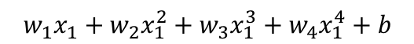
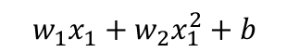

Overfitting: regression model
$$w_{1}x_{1}+w_{2}x_{1}^{2}+b$$
$$w_{1}x_{1}+w_{2}x_{1}^{2}+w_{3}x_{1}^{3}+w_{4}x_{1}^{4}+b$$
$$w_{1}x_{1}+b$$
Good model
Overfitting
Underfitting

Slide 22
Overfitting: classification model
Binary classifier draws a decision boundary

Slide 23
How to avoid overfitting
1. User fewer parameters (# of features)
Feature selection
Backward: start with full feature set, and remove one by one.
Forward: start with 1 feature, and add one by one.
2. Early stopping
Evaluate on dev set every now and then
Stop as soon as performance drops
3. Use regularization term
Restrict the magnitude of parameters
No prior knowledge about feature required

Slide 24
Regularization term
Idea: instead of minimize cost
Minimize(Cost(Data|Model))
We now minimize cost + complexity
Minimize(Cost(Data|Model) + complexity(Model))
Complexity can be quantified by L2 regularization term

Slide 25
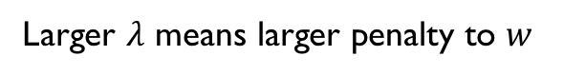
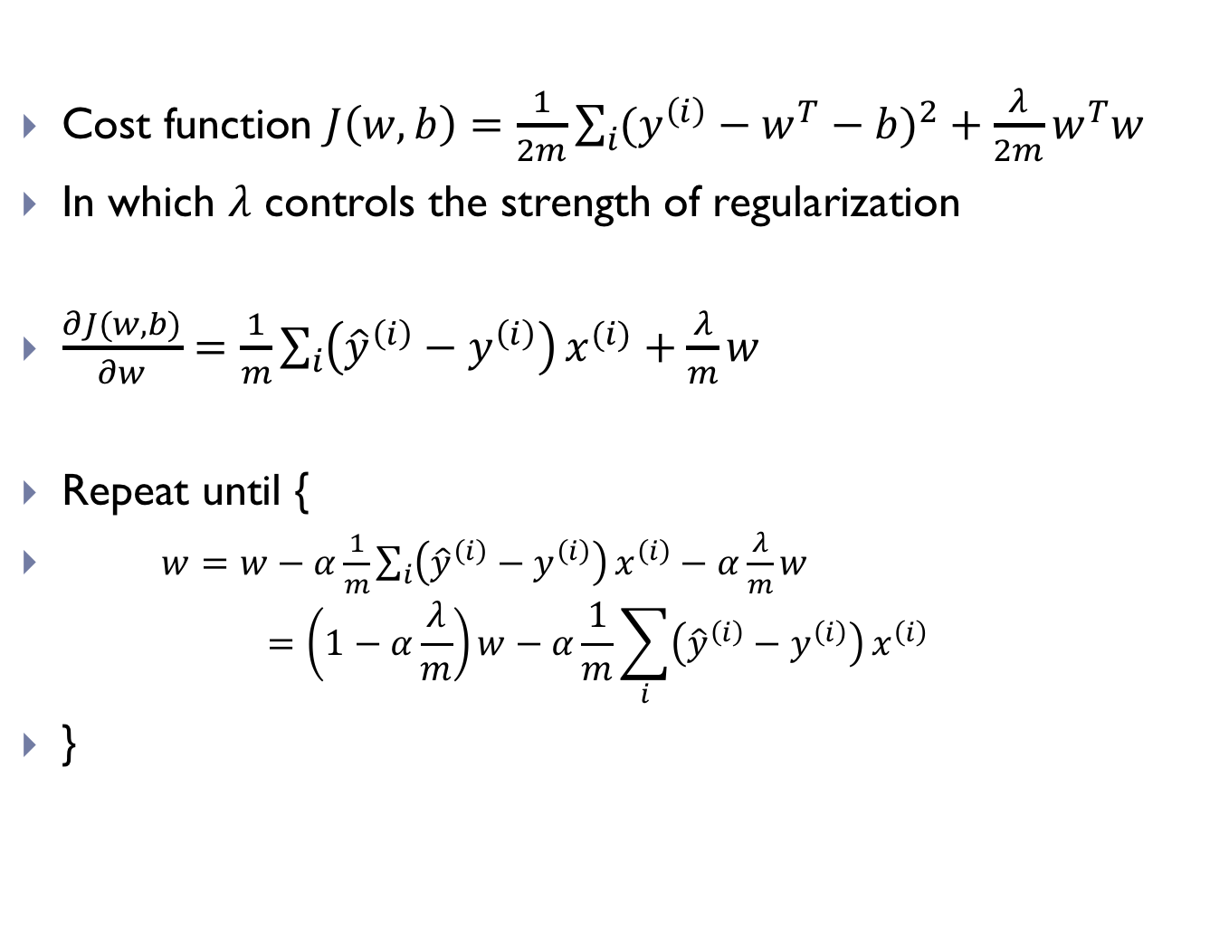
L2 regularization for linear regression
Cost function $J\left(w,b\right)=\frac{1}{2m}\sum_{i}{{(y^{\left(i\right)}−w^{T}−b)}^{2}}+\frac{λ}{2m}w^{T}w$
In which $λ$ controls the strength of regularization
$\frac{∂J(w,b)}{∂w}=\frac{1}{m}\sum_{i}{\left({\hat{y}}^{\left(i\right)}−y^{\left(i\right)}\right)}x^{(i)}+\frac{λ}{m}w$
Repeat until {
$w=w−α\frac{1}{m}\sum_{i}{\left({\hat{y}}^{\left(i\right)}−y^{\left(i\right)}\right)}x^{\left(i\right)}−α\frac{λ}{m}w$ $=\left(1−α\frac{λ}{m}\right)w−α\frac{1}{m}\sum_{i}{\left({\hat{y}}^{\left(i\right)}−y^{\left(i\right)}\right)}x^{\left(i\right)}$
}
Larger $λ$ means larger penalty to $w$

Slide 26
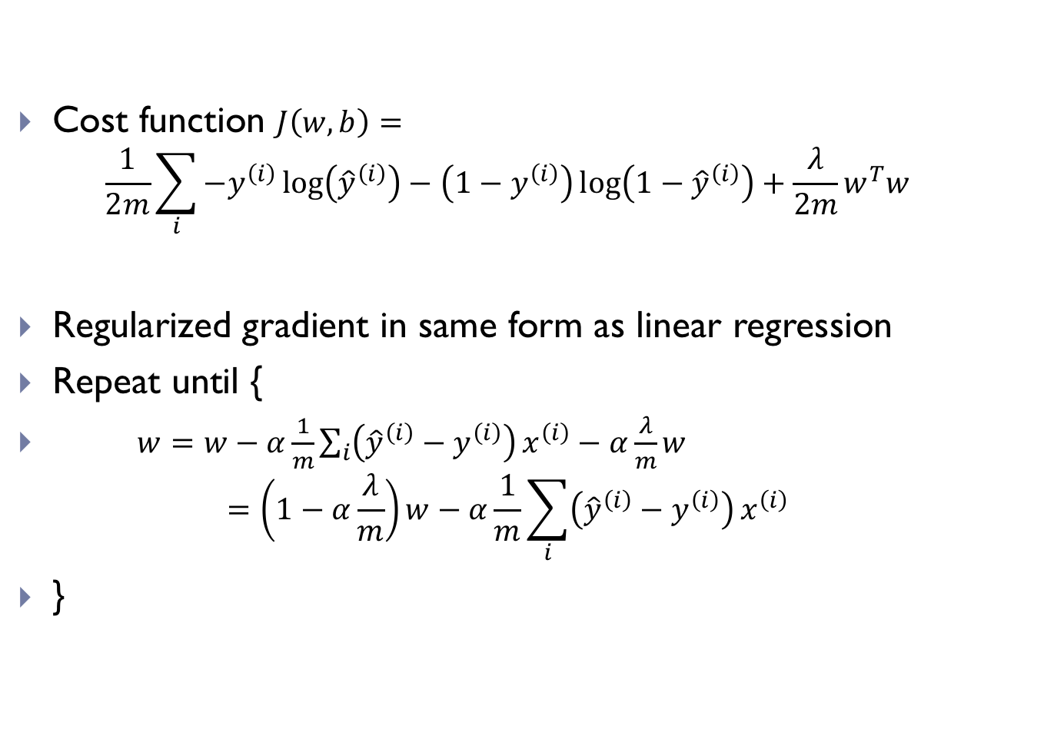
L2 regularization for logistic regression
Cost function $J\left(w,b\right)=$ $\frac{1}{2m}\sum_{i}{−y^{\left(i\right)}\log\left({\hat{y}}^{\left(i\right)}\right)−\left(1−y^{\left(i\right)}\right)\log\left(1−{\hat{y}}^{\left(i\right)}\right)}+\frac{λ}{2m}w^{T}w$
Regularized gradient in same form as linear regression
Repeat until {
$w=w−α\frac{1}{m}\sum_{i}{\left({\hat{y}}^{\left(i\right)}−y^{\left(i\right)}\right)}x^{\left(i\right)}−α\frac{λ}{m}w$ $=\left(1−α\frac{λ}{m}\right)w−α\frac{1}{m}\sum_{i}{\left({\hat{y}}^{\left(i\right)}−y^{\left(i\right)}\right)}x^{\left(i\right)}$
}

Slide 27
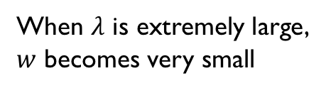

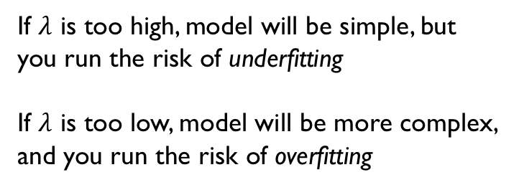
Outcome of L2 regularization
Smaller parameter values
Lower model complexity
Less likely to overfit
If $λ$ is too high, model will be simple, but you run the risk of underfitting
If $λ$ is too low, model will be more complex, and you run the risk of overfitting
When $λ$ is extremely large, $w$ becomes very small
https://developers.google.com/machine-learning/crash-course/regularization-for-simplicity/playground-exercise-examining-l2-regularization
$$w_{1}x_{1}+w_{2}x_{1}^{2}+w_{3}x_{1}^{3}+b$$

Slide 28
Next lecture
Computation graph
Vectorization in Python
Single layer neural network (Perceptron)

